Slide 1
London districts and schools
Coursera Capstone Project
March 2019

Slide 2
Introduction
London is one of the cities places to live
BUT…expensive childcare and housing!
This project looks at:
London postal districts – K-Means clustering by venue type
London state schools – creating a map with the best free schools

Slide 3
Data
A list of the London’s postal districts, their names and postal IDs
Data on London schools, their URNs, names, types, OFSTED ratings and postcodes
Foursquare API, Folium, Nominatim

Slide 4
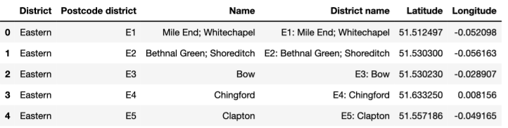
Methodology: London districts
1. Download the data and getting coordinates of the districts:

Slide 5
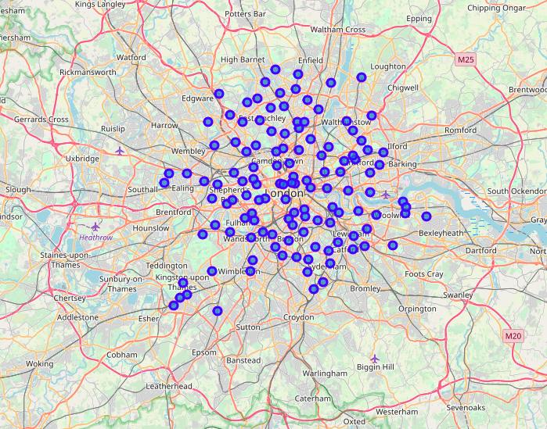
Methodology: London districts
2. Create a map of London:

Slide 6

Methodology: London districts
3. Use Foursquare API to find the most popular venue types (326 unique values found in total):

Slide 7
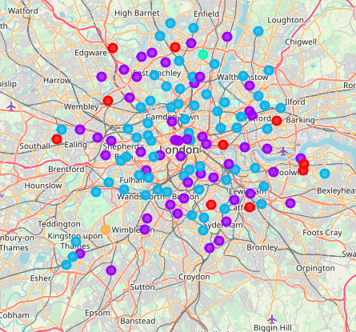
Methodology: London districts
4. Use K-Means Clustering algorithm to split the districts:

Slide 8
Methodology: London schools
Download and clean the data:
Irrelevant columns deleted;
Only kept schools which satisfy the following criteria:
Located in Inner and Outer London;
State schools (Maintained schools);
Mixed or Girls only;
Have an outstanding OFSTED rating (Overall effectiveness of 1).
After cleaning the data only 398 schools left.

Slide 9
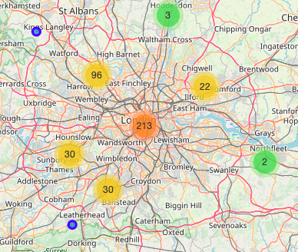
Methodology: London schools
2. Place the schools onto a map:

Slide 10
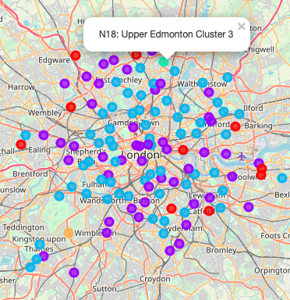
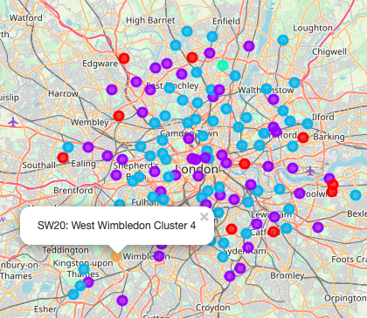
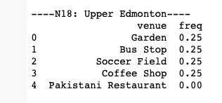
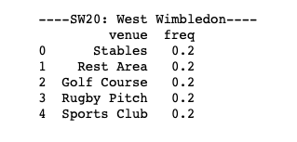
Results: London districts
2 rogue districts:

Slide 11
Results: London districts
Other districts look sensible:
Most popular venues: pubs, coffee shops, cafes and grocery shops
The K-Means Cluster algorithm has split the districts accordingly, with most central locations split in 2 clusters and some more rural areas assigned a different cluster

Slide 12
Results: London schools
Results look sensible:
The best schools are in the more expensive areas (Central, South-West, North)
The resulting map is a useful tool, as it enables the user to zoom in and out to do the following:
check the locations of the outstanding state schools
check how close they are to the user’s current home to estimate how difficult it is to get admission into one of the schools. If you live in the overlapping circles it means there is more than one school next to you, so there are more chances to get admitted
check where to move, if a family has a preferred school of their choice to maximise their chances of getting admitted

Slide 13
Discussion / Next Steps
To gain a better picture one could also do some further analysis based on his circumstances, for example;
Narrow down the schools further (e.g. by religion denomination or by territory).
Instead of using the ‘Overall effectiveness’ rating one could use a different metrics like, GCSEs, A-level results or admissions to universities.
Check the demographics of each area and calculate the ratio of good schools to the number of children – the lower the ratio, the harder it is to get admitted.
Create a Choropleth maps showing the number of schools and the property prices next to them.
Analyse the property prices or rental yields next to the preferred schools in more detail.
Collect as much data as possible about the preferred list of schools.

Slide 14
Q&A
Thank you for your attention!

